Slide 1

Fundamentals of Python:
First Programs
Chapter 6: Design
with Functions

Slide 2

Objectives
After completing this chapter, you will be able to:
Explain why functions are useful in structuring code in a program
Employ top-down design to assign tasks to functions
Define a recursive function
Fundamentals of Python: First Programs

Slide 3
Objectives (continued)
Explain the use of the namespace in a program and exploit it effectively
Define a function with required and optional parameters
Use higher-order functions for mapping, filtering, and reducing
Fundamentals of Python: First Programs

Slide 4
Functions as Abstraction Mechanisms
An abstraction hides detail
  Allows a person to view many things as just one thing
We use abstractions to refer to the most common tasks in everyday life
  For example, the expression “doing my laundry”
Effective designers must invent useful abstractions to control complexity
Fundamentals of Python: First Programs

Slide 5
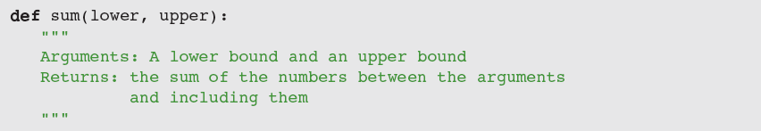
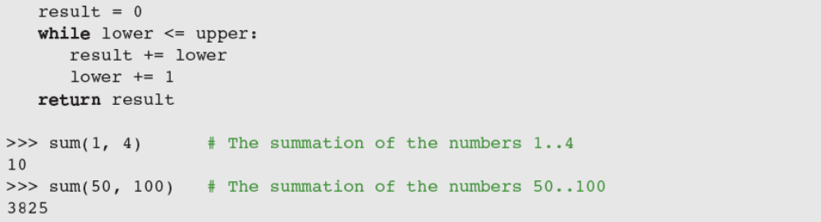
Functions Eliminate Redundancy
Functions serve as abstraction mechanisms by eliminating redundant, or repetitious, code
Fundamentals of Python: First Programs

Slide 6
Functions Hide Complexity
Functions serve as abstraction mechanisms is by hiding complicated details
For example, consider the previous sum function
  The idea of summing a range of numbers is simple; the code for computing a summation is not
A function call expresses the idea of a process to the programmer
  Without forcing him/her to wade through the complex code that realizes that idea
Fundamentals of Python: First Programs

Slide 7
Functions Support General Methods with Systematic Variations
An algorithm is a general method for solving a class of problems
The individual problems that make up a class of problems are known as problem instances
  What are the problem instances of our summation algorithm?
Algorithms should be general enough to provide a solution to many problem instances
  A function should provide a general method with systematic variations
Fundamentals of Python: First Programs

Slide 8
Functions Support the Division of Labor
In a well-organized system, each part does its own job in collaborating to achieve a common goal
In a computer program, functions can enforce a division of labor
  Each function should perform a single coherent task
    Example: Computing a summation
Each of the tasks required by a system can be assigned to a function
  Including the tasks of managing or coordinating the use of other functions
Fundamentals of Python: First Programs

Slide 9
Problem Solving with Top-Down Design
Top-down design starts with a global view of the entire problem and breaks the problem into smaller, more manageable subproblems
  Process known as problem decomposition
As each subproblem is isolated, its solution is assigned to a function
As functions are developed to solve subproblems, solution to overall problem is gradually filled out
  Process is also called stepwise refinement
Fundamentals of Python: First Programs

Slide 10
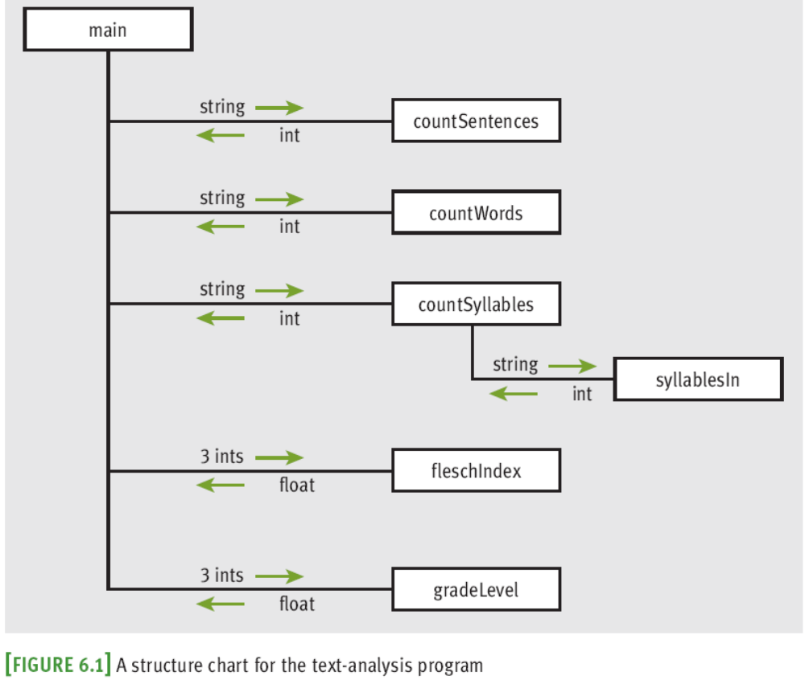
The Design of the Text-Analysis Program
Fundamentals of Python: First Programs

Slide 11
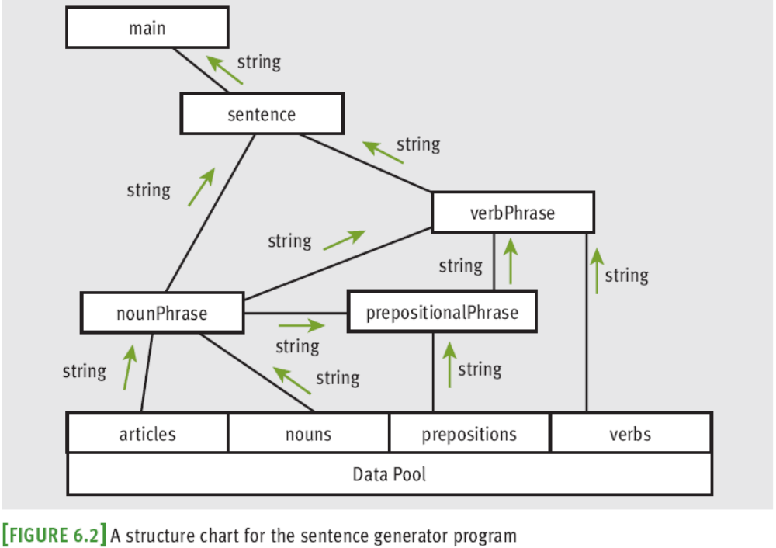
The Design of the Sentence-Generator Program
Fundamentals of Python: First Programs

Slide 12
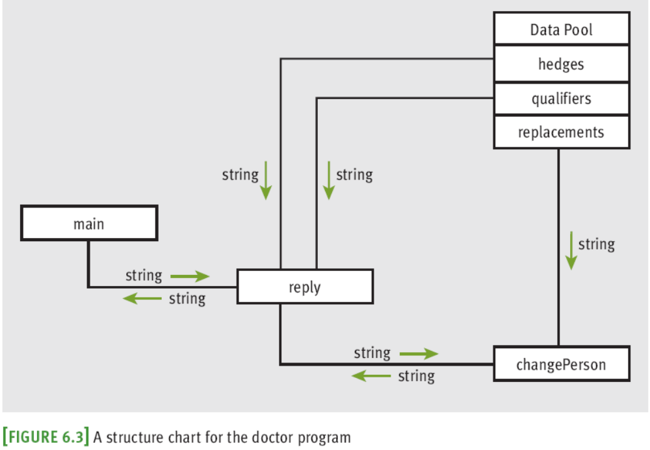
The Design of the Doctor Program
Fundamentals of Python: First Programs

Slide 13
Design with Recursive Functions
In top-down design, you decompose a complex problem into a set of simpler problems and solve these with different functions
In some cases, you can decompose a complex problem into smaller problems of the same form
  Subproblems can be solved using the same function
    This design strategy is called recursive design
    Resulting functions are called recursive functions
Fundamentals of Python: First Programs

Slide 14
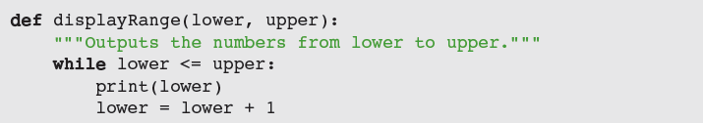
Defining a Recursive Function
A recursive function is a function that calls itself
  To prevent function from repeating itself indefinitely, it must contain at least one selection statement
    Statement examines base case to determine whether to stop or to continue with another recursive step
To convert displayRange to a recursive function:
  You can replace loop with a selection statement and assignment statement with a recursive call
Fundamentals of Python: First Programs

Slide 15
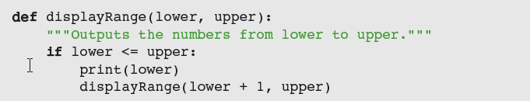
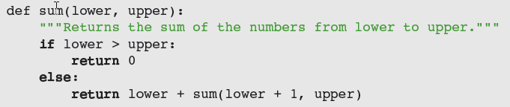
Defining a Recursive Function (continued)
Making displayRange recursive (continued):
Most recursive functions expect at least one argument
Another example: Recursive version of sum
Fundamentals of Python: First Programs

Slide 16
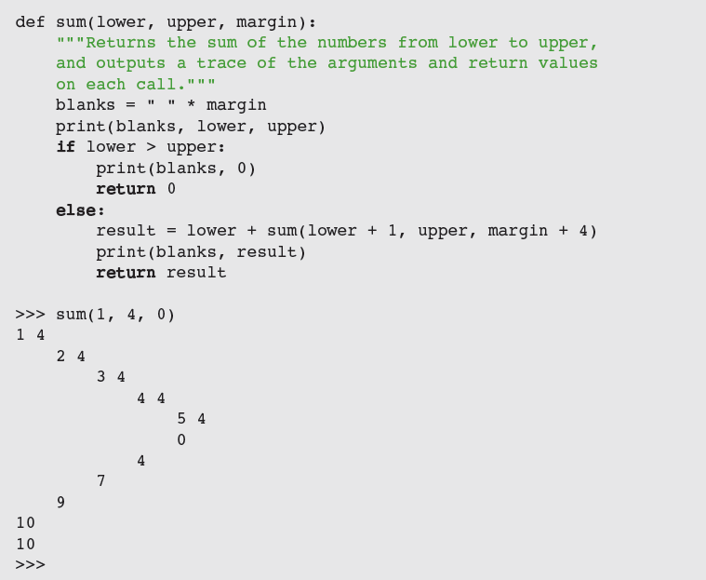
Tracing a Recursive Function
Fundamentals of Python: First Programs

Slide 17
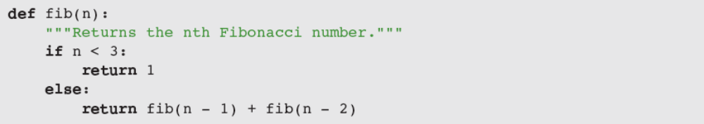
Using Recursive Definitions to Construct Recursive Functions
Recursive functions are frequently used to design algorithms that have a recursive definition
  A recursive definition consists of equations that state what a value is for one or more base cases and one or more recursive cases
Example: Fibonacci sequence
  1 1 2 3 5 8 13 . . .
Fundamentals of Python: First Programs

Slide 18
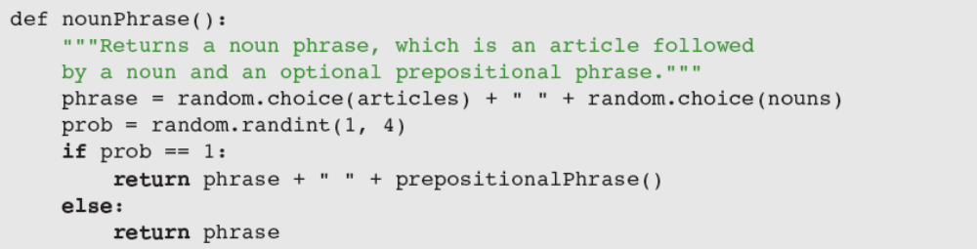
Recursion in Sentence Structure
Recursive solutions can often flow from the structure of a problem
Example: Structure of sentences in a language
  A noun phrase can be modified by a prepositional phrase, which also contains another noun phrase
    ← Indirect recursion
Fundamentals of Python: First Programs

Slide 19
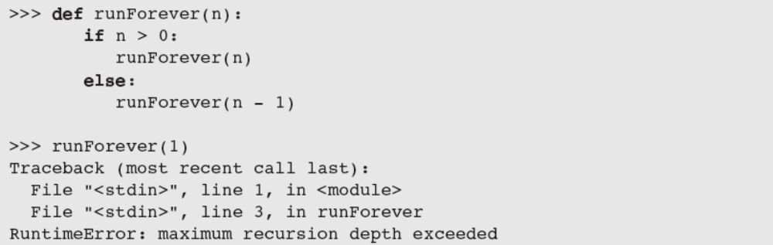
Infinite Recursion
Infinite recursion arises when programmer fails to specify base case or to reduce size of problem in a way that terminates the recursive process
  In fact, the Python virtual machine eventually runs out of memory resources to manage the process
Fundamentals of Python: First Programs

Slide 20
The Costs and Benefits of Recursion
PVM reserves an area of memory for the call stack
For each call of a function, the PVM must allocate on the call stack a stack frame, which contains:
  Values of the arguments
  Return address for the particular function call
  Space for the function call’s return value
When a call returns, return address is used to locate the next instruction, and stack frame is deallocated
Amount of memory needed for a loop does not grow with the size of the problem’s data set
Fundamentals of Python: First Programs

Slide 21
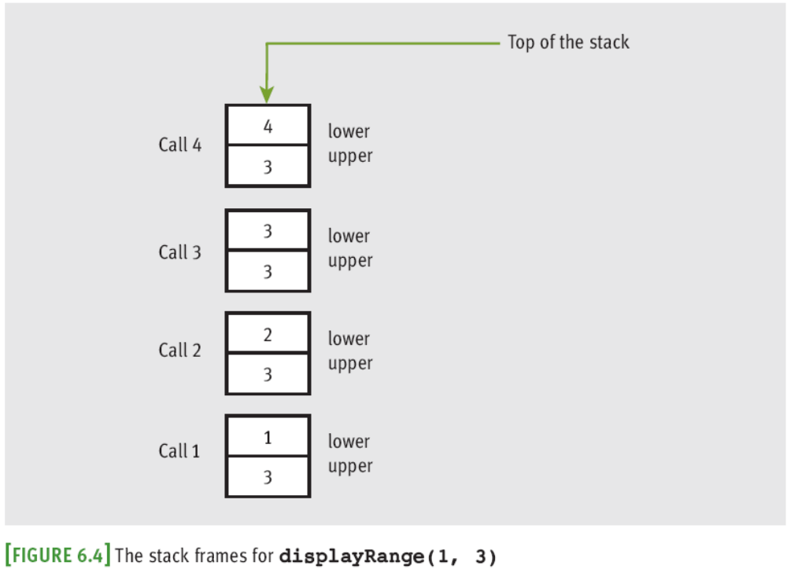
The Costs and Benefits of Recursion (continued)
Fundamentals of Python: First Programs

Slide 22
Case Study: Gathering Information from a File System
Request: Write a program that allows the user to obtain information about the file system
Analysis:
  File systems are tree-like structures
  At the top of the tree is the root directory
  Under the root are files and subdirectories
  Each directory in the system except the root lies within another directory called its parent
  Example of a path (UNIX-based file system):
    /Users/KenLaptop/Book/Chapter6/Chapter6.doc
Fundamentals of Python: First Programs

Slide 23
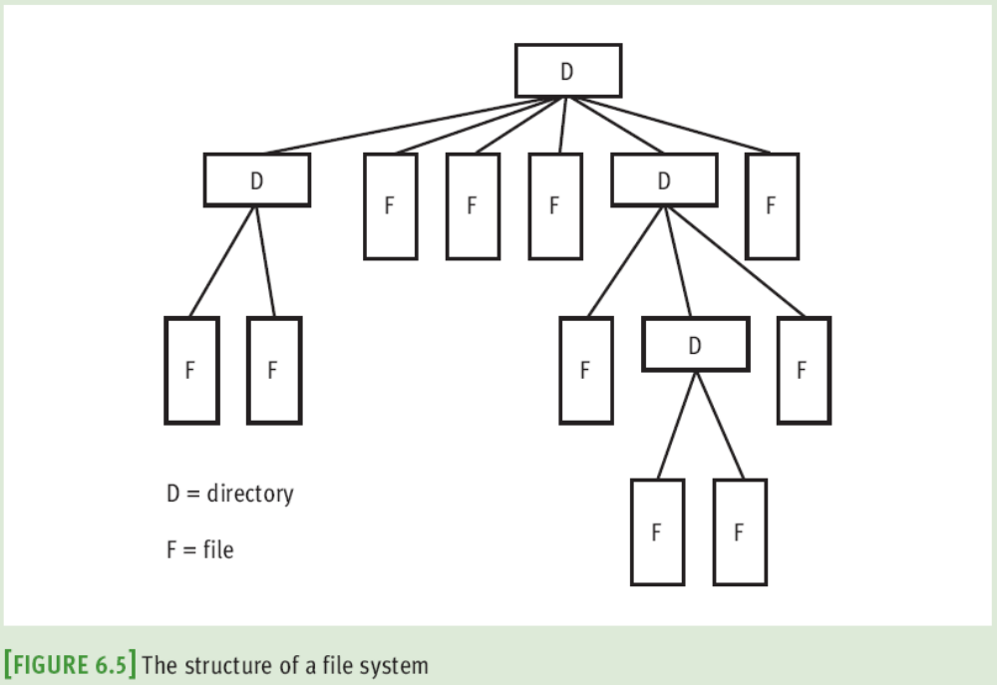
Case Study: Gathering Information from a File System (continued)
Fundamentals of Python: First Programs

Slide 24
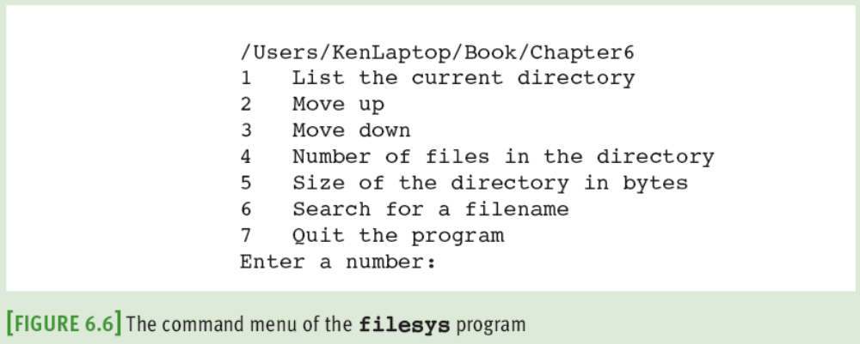
Case Study: Gathering Information from a File System (continued)
  When user enters a number, program runs command; then, displays CWD and menu again
  An unrecognized command produces an error message
Fundamentals of Python: First Programs

Slide 25
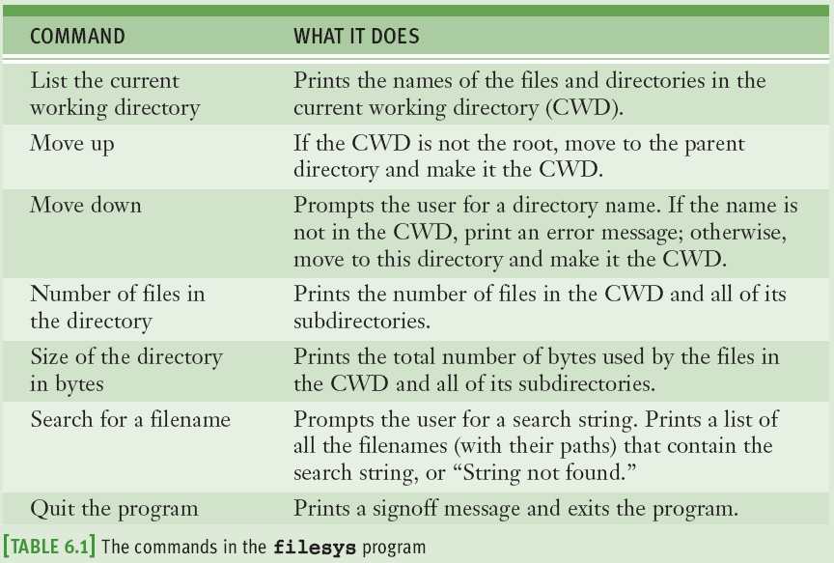
Case Study: Gathering Information from a File System (continued)
Fundamentals of Python: First Programs

Slide 26
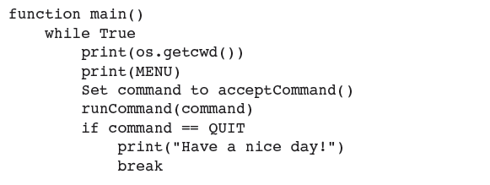
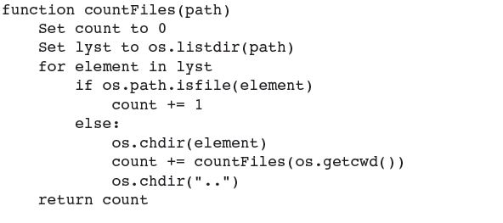
Case Study: Gathering Information from a File System (continued)
Design:
Fundamentals of Python: First Programs

Slide 27
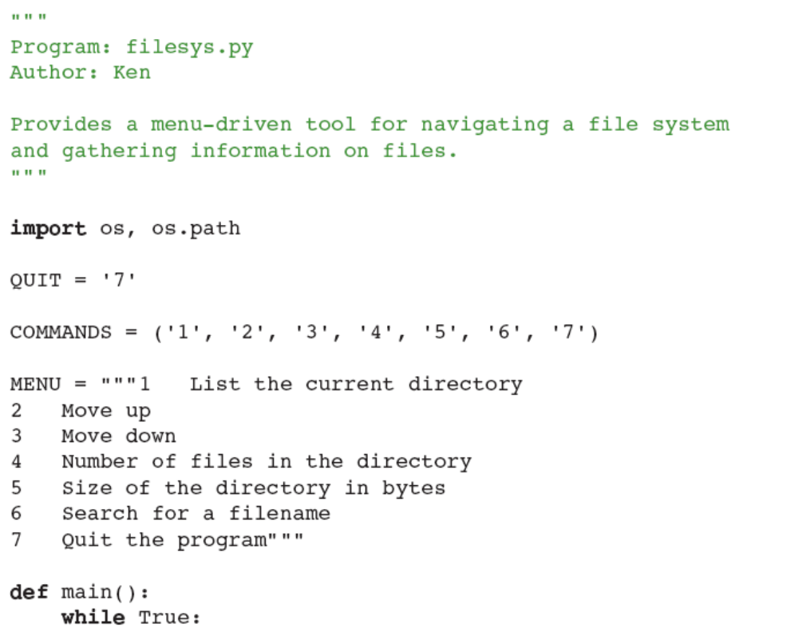
Case Study: Gathering Information from a File System (continued)
…
Fundamentals of Python: First Programs

Slide 28
Managing a Program’s Namespace
A program’s namespace is the set of its variables and their values
  You can control it with good design principles
Fundamentals of Python: First Programs

Slide 29
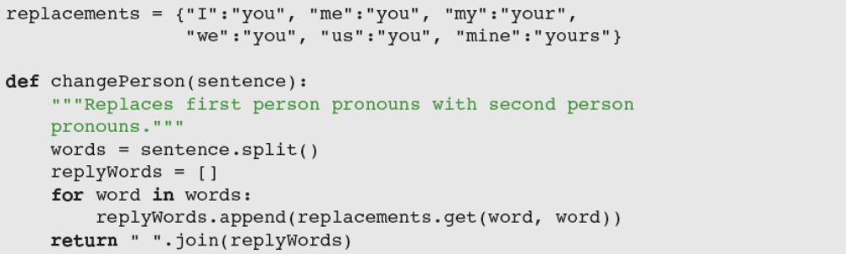
Module Variables, Parameters, and Temporary Variables
doctor.py file (module name is doctor):
Module variables and temporary variables receive their values as soon as they are introduced
Parameters behave like a variable and are introduced in a function or method header
  Do not receive a value until the function is called
A module variable A parameter name
A temporary variable
A method name
Fundamentals of Python: First Programs

Slide 30
Scope
Scope: Area in which a name refers to a given value
  Temporary variables are restricted to the body of the functions in which they are introduced
  Parameters are invisible outside function definition
  The scope of module variables includes entire module below point where they are introduced
    A function can reference a module variable, but can’t under normal circumstances assign a new value to it
Fundamentals of Python: First Programs

Slide 31
Lifetime
Variable’s lifetime: Period of time when variable has memory storage associated with it
  When a variable comes into existence, storage is allocated for it; when it goes out of existence, storage is reclaimed by the PVM
Module variables come into existence when introduced and generally exist for lifetime of program that introduces or imports them
Parameters and temporary variables come into existence when bound to values during call, but go out of existence when call terminates
Fundamentals of Python: First Programs

Slide 32
Default (Keyword) Arguments
Arguments provide the function’s caller with the means of transmitting information to the function
Programmer can specify optional arguments with default values in any function definition:
  Following the required arguments are one or more default or keyword arguments
  When function is called with these arguments, default values are overridden by caller’s values
Fundamentals of Python: First Programs

Slide 33
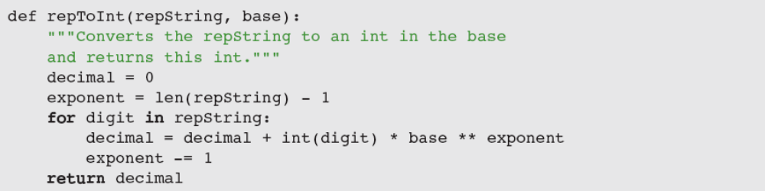
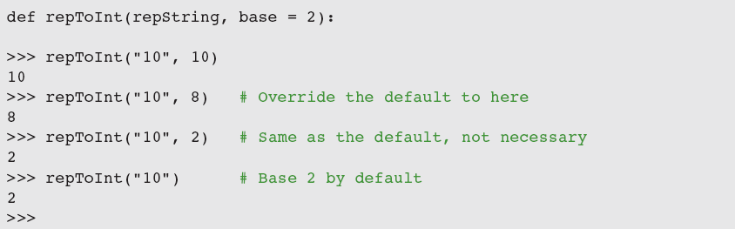
Default (Keyword) Arguments (continued)
Fundamentals of Python: First Programs

Slide 34
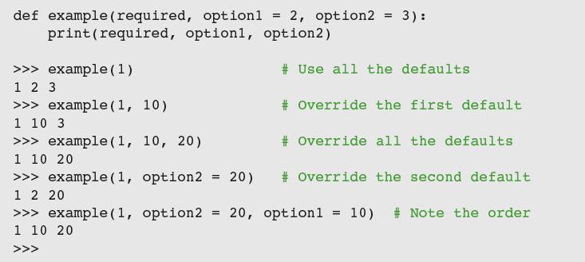
Default (Keyword) Arguments (continued)
The default arguments that follow can be supplied in two ways:
  By position
  By keyword
Fundamentals of Python: First Programs

Slide 35
Higher-Order Functions
(Advanced Topic)
A higher-order function expects a function and a set of data values as arguments
  Argument function is applied to each data value and a set of results or a single data value is returned
A higher-order function separates task of transforming each data value from logic of accumulating the results
Fundamentals of Python: First Programs

Slide 36
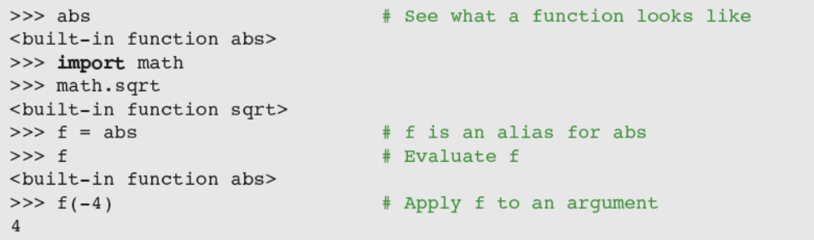
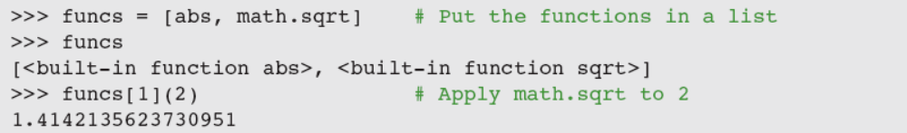
Functions as First-Class Data Objects
Functions can be assigned to variables, passed as arguments, returned as the values of other functions, and stored in data structures
Fundamentals of Python: First Programs

Slide 37
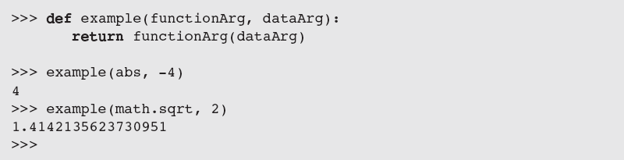
Functions as First-Class Data Objects (continued)
Passing a function as an argument is no different from passing any other datum:
Fundamentals of Python: First Programs

Slide 38
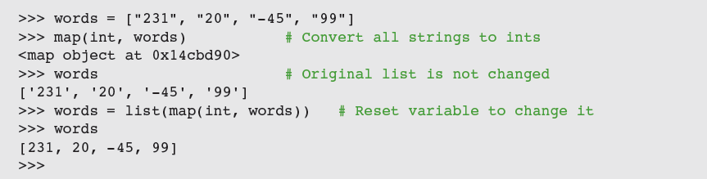
Mapping
Mapping applies a function to each value in a sequence and returns a new sequence of the results
Fundamentals of Python: First Programs

Slide 39
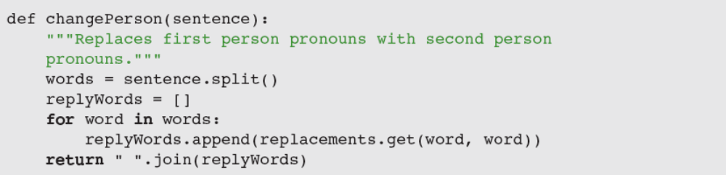
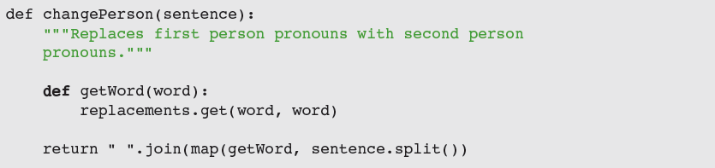
Mapping (continued)
Fundamentals of Python: First Programs

Slide 40
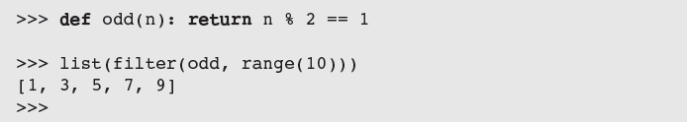
Filtering
When filtering, a function called a predicate is applied to each value in a list
  If predicate returns True, value is added to a new list; otherwise, value is dropped from consideration
Fundamentals of Python: First Programs

Slide 41
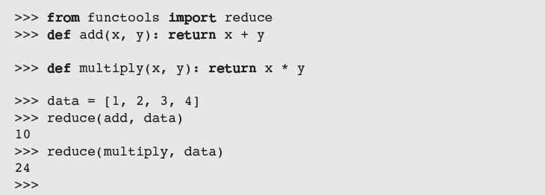
Reducing
When reducing, we take a list of values and repeatedly apply a function to accumulate a single data value
Fundamentals of Python: First Programs

Slide 42
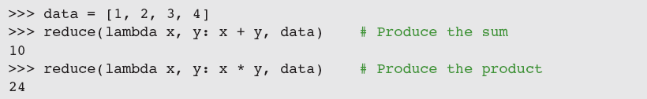
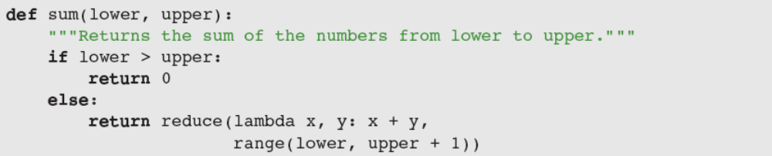
Using lambda to Create Anonymous Functions
A lambda is an anonymous function
  When the lambda is applied to its arguments, its expression is evaluated and its value is returned
Fundamentals of Python: First Programs

Slide 43
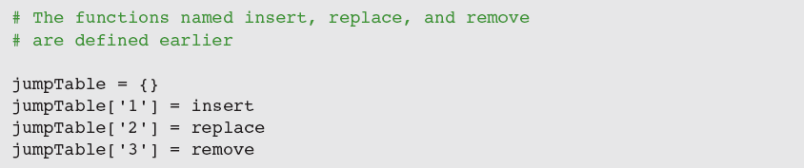
Creating Jump Tables
A jump table is a dictionary of functions keyed by command names
Fundamentals of Python: First Programs

Slide 44
Summary
A function serves as abstraction mechanism and eliminates redundant patterns of code
Top-down design is strategy that decomposes complex problem into simpler subproblems and assigns their solutions to functions
A structure chart is diagram of relationships among cooperating functions
Recursive design is special case of top-down design, in which complex problem is decomposed into smaller problems of the same form
Fundamentals of Python: First Programs

Slide 45
Summary (continued)
A recursive function is a function that calls itself
  Parts: Base case and recursive step
  Can be computationally expensive
Programmers must avoid infinite recursion
Program namespace structured in terms of module variables, parameters, and temporary variables
Scope can be used to control the visibility of names in a namespace
The lifetime of a variable is duration of program execution during which it uses memory storage
Fundamentals of Python: First Programs

Slide 46
Summary (continued)
Functions are first-class data objects
Higher-order functions can expect other functions as arguments and/or return functions as values
A mapping function expects a function and a list of values as arguments
A predicate is a Boolean function
A filtering function expects a predicate and a list of values as arguments
A reducing function expects a function and a list of values as arguments
Fundamentals of Python: First Programs

